Slide 1

Presentation on
Malignant Comments Classification
Presented By: Ravi Kumar Sharma

Slide 2
Agenda
Introduction
Problem Statement
Problem Understanding
Definition and Importance of Malignant Comments Classification?
Data Analysis & Model Building Flowchart
Exploratory Data Analysis Steps
Visualizations
Data Analysis Steps Done
Model Building
Hyper Parameter Tuning and Crating Final Model
ROC-AUC Curve
Saving the model and prediction results
Conclusion

Slide 3
Introduction
Over the years, social media and social networking use have been increasing exponentially due to an upsurge in the use of the internet. Flood of information arises from online conversation in a daily basis as people are able discuss, express themselves and air their opinion via these platforms.
Every day, we get a tremendous amount of short content data from the blast of online correspondence, web-based business and the utilization of advanced gadgets. This volume of data requires text mining apparatuses to carry out the various report tasks in an opportune and suitable way. Detecting and controlling verbal abuse in an automated fashion is inherently an NLP task (Natural Language Processing). Text Classification is a great point for NLP.
Nowadays, every social media site and applications use machine learning approach. Machine Learning has simplified the task that may take long duration to complete without it. Most of the approaches require text analysis and classification techniques. Classification of the comments is necessary before posting on online platforms. This paper discusses different methodologies like logistic regression, support vector machine, multinomial naïve bayes etc. for comment classification into 6 different categories viz. malignant, highly malignant, rude, threat, abuse and loathe.

Slide 4
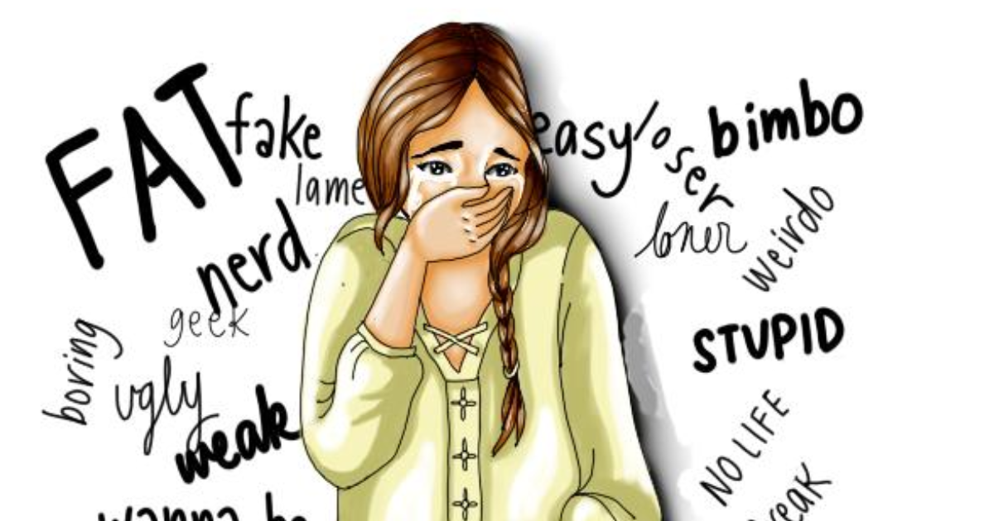
Problem Statement
The proliferation of social media enables people to express their opinions widely online. However, at the same time, this has resulted in the emergence of conflict and hate, making online environments uninviting for users. Although researchers have found that hate is a problem across multiple platforms, there is a lack of models for online hate detection.
Online hate, described as abusive language, aggression, cyberbullying, hatefulness and many others has been identified as a major threat on online social media platforms. Social media platforms are the most prominent grounds for such toxic behaviour. There has
been a remarkable increase in the cases of cyberbullying and trolls on various social media platforms. Many celebrities and influences are facing backlashes from people and have to come across hateful and offensive comments. This can take a toll on anyone and affect them mentally leading to depression, mental illness, self-hatred and suicidal thoughts.
Internet comments are bastions of hatred and vitriol. While online anonymity has provided a new outlet for aggression and hate speech, machine learning can be used to fight it. The problem we sought to solve was the tagging of internet comments that are aggressive towards other users. This means that insults to third parties such as celebrities will be tagged as unoffensive, but “u are an idiot” is clearly offensive.

Slide 5


Problem Understanding
In the past few years, it is seen that the cases related to social media hatred have increased exponentially. The social media is turning into a dark venomous pit for people now a days. Online hate is the result of difference in opinion, race, religion, occupation, nationality etc. In social media the people spreading or involved in such kind of activities uses filthy languages, aggression, images etc. to offend and gravely hurt the person on the other side. This is one of the major concerns now.
The result of such activities can be dangerous. It gives mental trauma to the victims making their lives miserable. People who are not well aware of mental health online hate or cyberbullying become life threatening for them. Such cases are also at rise. It is also taking its toll on religions. Each and every day we can see an incident of fighting between people of different communities or religions due to offensive social media posts.
Online hate, described as abusive language, aggression, cyberbullying, hatefulness, insults, personal attacks, provocation, racism, sexism, threats, or toxicity has been identified as a major threat on online social media platforms. These kinds of activities must be checked for a better future.

Slide 6
Definition & Importance of Malignant Comments Classification
Definition: “A Classification model designed to detect the type of toxic comments to detect and prevent cyberbullying” which include unsupportive and unpleasant behavior, being manipulative, judgmental, controlling, and self-centered.
Importance: Every day, we get a tremendous amount of short content data from the blast of online correspondence, web-based business and the utilization of advanced gadgets. This volume of data requires text mining apparatuses to carry out the various report tasks in an opportune and suitable way. Detecting and controlling verbal abuse in an automated fashion is inherently an NLP task (Natural Language Processing). Text Classification is a great point for NLP.
Nowadays, every social media site and applications use machine learning approach. Machine Learning has simplified the task that may take long duration to complete without it. Most of the approaches require text analysis and classification techniques. Classification of the comments is necessary before posting on online platforms. This classification model helps to prevent the online abuse and cyberbullying.

Slide 7
Data Analysis and Model Building Flowchart
Import Libraries
Import Dataset
Feature Engineering
Checking Correlation
NLTK Text Pre-Processing
Visualizations
(EDA)
TF-IDF Vectorizer
Data Balancing
Model Building
Saving the model and Predictions
AUC-ROC Curve
Hyper Parameter Tuning

Slide 8
Exploratory Data Analysis (EDA) Steps
Importing necessary libraries and importing dataset as a data frame.
Checked some statistical information like shape, number of unique values present, info, finding zero values etc.
Checked for null values and did not find any null values. And removed Id.
Done feature engineering and created new columns viz label: which contain both good and bad comments which is the sum of all the labels, comment_length: which contains the length of comment text.
Visualized each feature using seaborn and matplotlib libraries by plotting categorical plots like pie plot, count plot, distribution plot and wordcloud for each label.
Done text pre-processing techniques like Removing Punctuations and other special characters, Splitting the comments into individual words, Removing Stop Words, Stemming and Lemmatization. Then created new column as clean_length after cleaning the data. All these steps were done on both train and test datasets. Checked correlation using heatmap. After getting a cleaned data used TF-IDF vectorizer.

Slide 9
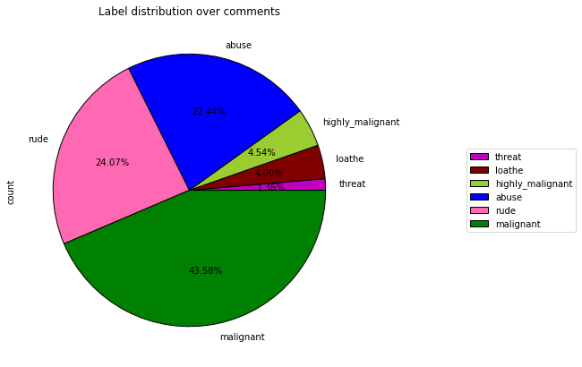
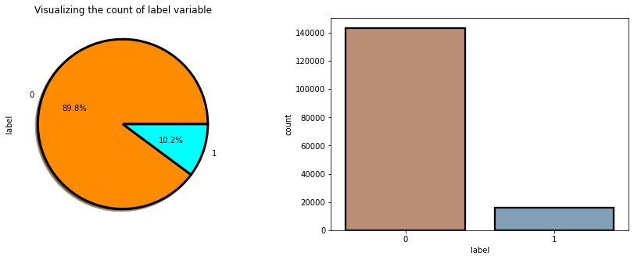
Visualizations
From the pie chart we can notice approximately 43% of the comments are malignant, 24% of the comments are rude and 22% are abuse. The count of malignant comments are high compared to other type of comments and the count of threat comments are very less.
From the above plots we can observe the count of negative comments are high compared to the non negative comments. Here around 90% of the comments are turned out to be a negative comments and only 10% of them are considered to be positive or neutral comments. We can also observe the data imbalance issue here, we need to balance the data.

Slide 10
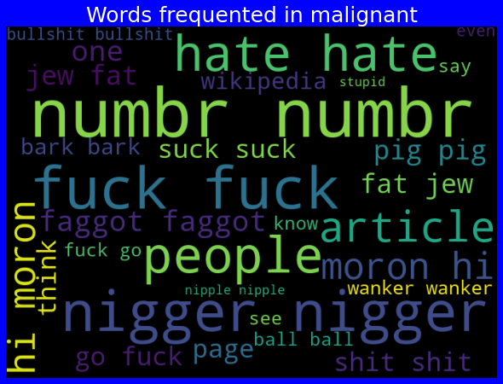
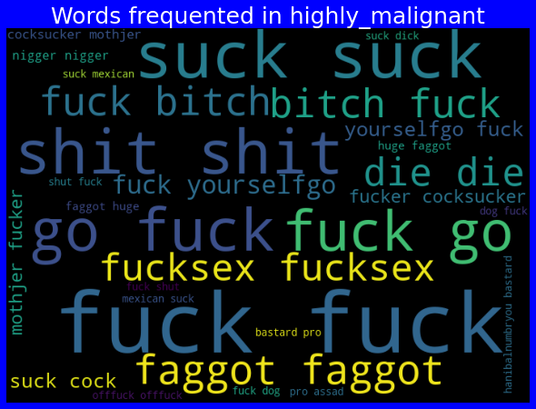
Visualizations
From the above plots we can clearly see the loud words which are occurred most frequently in malignant and highly malignant comments respectively.

Slide 11
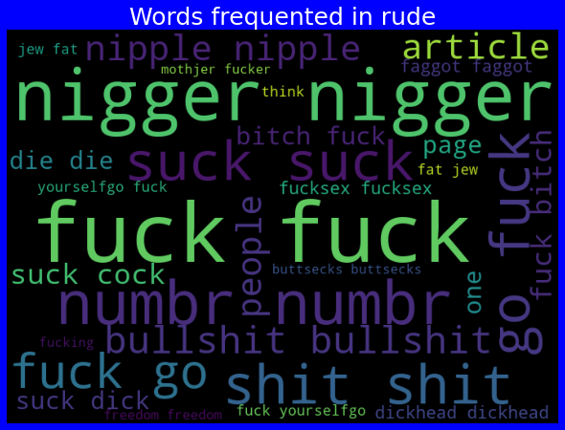
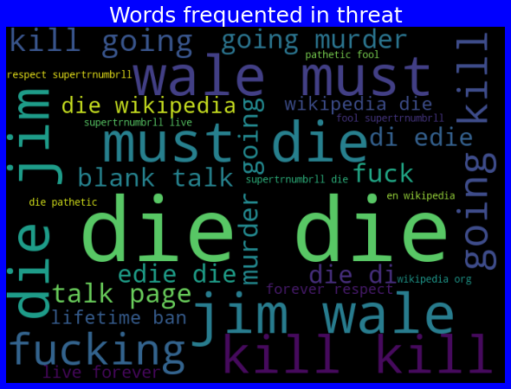
Visualizations
From the above plots we can clearly see the loud words which are occurred most frequently in rude and threat comments respectively.

Slide 12
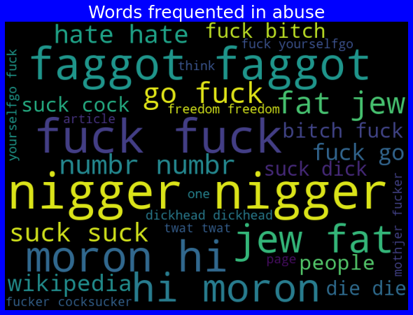
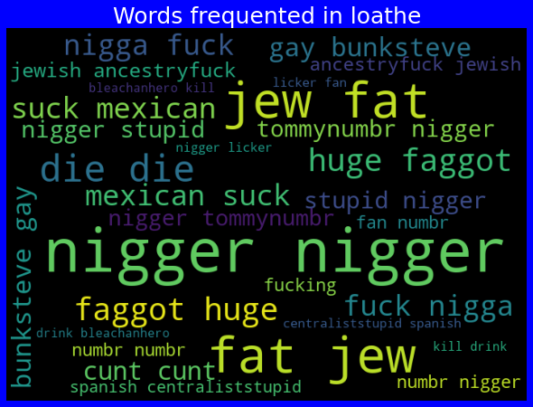
Visualizations
From the above plots we can clearly see the loud words which are occurred most frequently in rude and threat comments respectively.

Slide 13
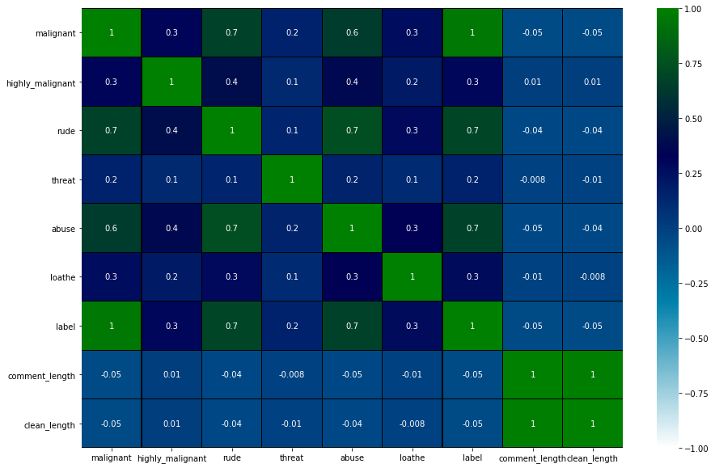
Correlation between features and labels
This heatmap shows the correlation matrix of the data. We can observe the relation between one feature to other and relation between features and label.
From the heat map we can observe the features have some strong relation with each other. We can also observe multicollinearity problem.

Slide 14
Data Analysis Steps done
I have extracted some features and removed the feature “Id” to improve data normality and linearity.
Done text pre-processing techniques like
  Removing Punctuations and other special characters,
  Splitting the comments into individual words,
  Removing Stop Words,
  Stemming and Lemmatization.
Then created new column as clean_length after cleaning the data. All these steps were done on both train and test datasets. Used Pearson’s correlation coefficient and heat map to check the correlation.
After getting a cleaned data used TF-IDF vectorizer. It’ll help to transform the text data to feature vector which can be used as input in our modelling. It is a common algorithm to transform text into numbers. It measures the originality of a word by comparing the frequency of appearance of a word in a document with the number of documents the words appear in.
Balanced the data using Randomoversampler mechanism.
Split train and test to build machine learning models. Model building process will be shown in the further steps.

Slide 15
Model Building:
In this project there were 6 features which defines the type of comment like malignant, hate, abuse, threat, loathe but we created another feature named as “label” which is combined of all the above features and contains the labelled data into the format of 0 and 1 where 0 represents “NO” and 1 represents “Yes”. In this NLP based project we need to predict the multiple labels which are binary. I have converted text into feature vectors using TF-IDF vectorizer and separated our feature and labels. Also, before building the model, I made sure that the input data is cleaned and scaled before it was fed into the machine learning models.
After the pre-processing and data cleaning I used remaining independent features for model building and prediction. The classification algorithms used on training the data are as follows:
  Logistic Regression
  MultinomialNB
  LightGBM Classifier
  LinearSVC
  Gradient Boosting Classifier
  Decision Tree Classifier
  Extreme Gradient Boosting Classifier (XGB)
  AdaBoost Classifier

Slide 16
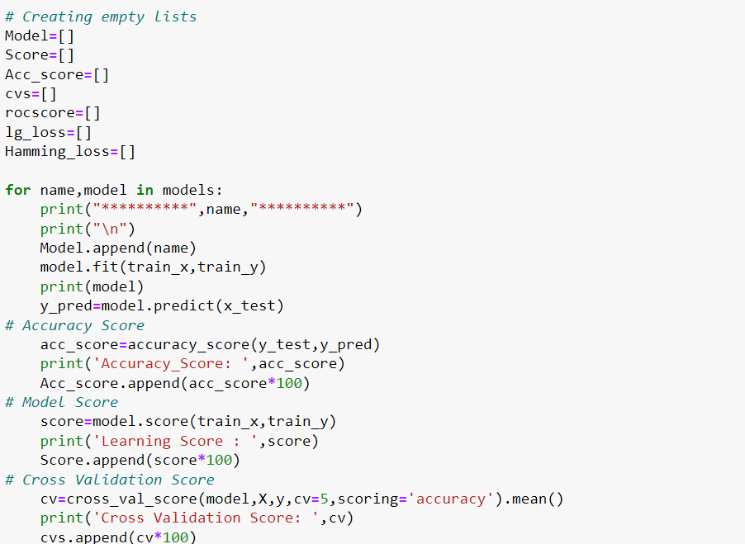
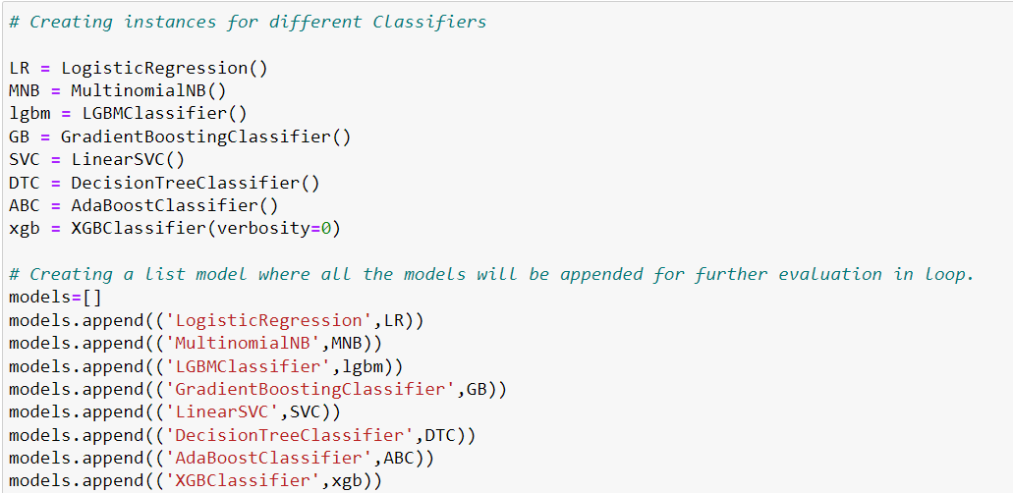
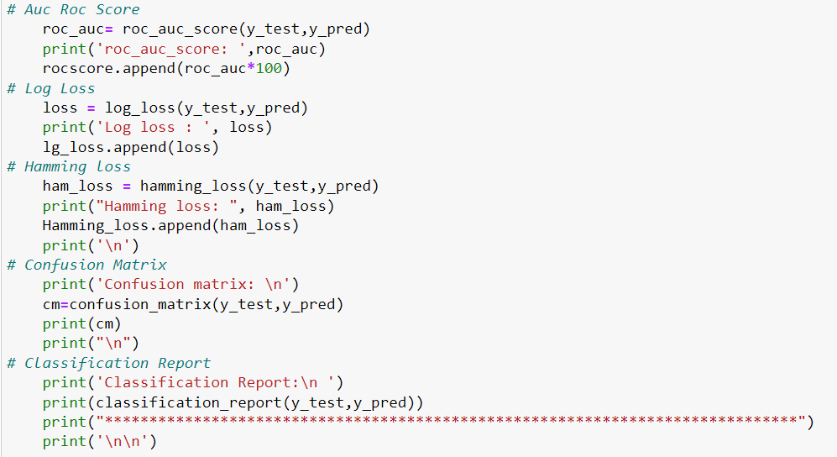
First creating instances for different classifier and then listed down the models that will be appended for further evaluation in for loop as shown.

Slide 17
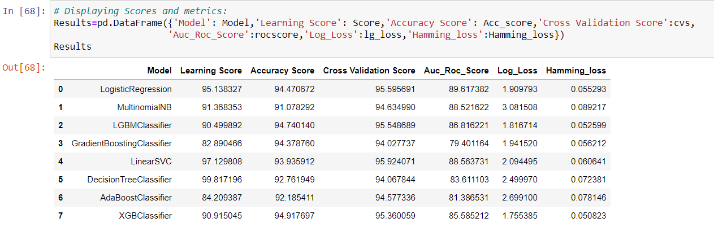
Model Selection
After creating and training different classification algorithms, we can see that the difference between accuracy and cross validation score is less for "Extreme Gradient Boosting Classifier (XGBClassifier)" and Gradient Boosting Classifier. But, XGBClassifier giving less loss values, auc roc score and high accuracy score compared to Gradient Boosting Classifier. On this basis I can conclude that "XGBClassifier" as the best fitting model. Now, we will try Hyperparameter Tuning to find out the best parameters and using them to improve the scores and metrics values.

Slide 18
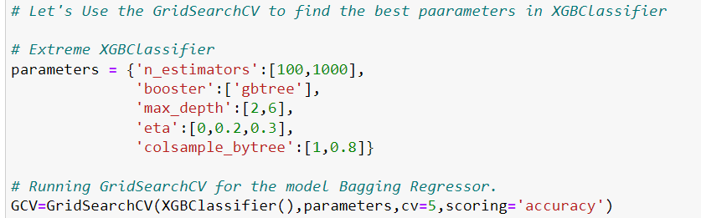
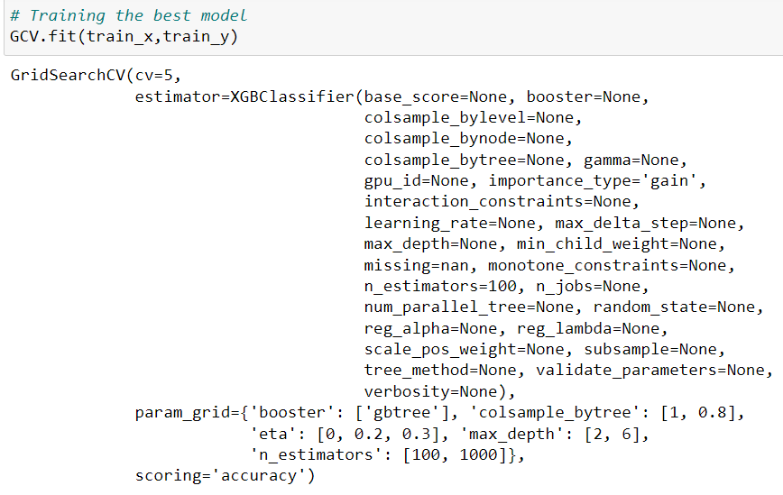
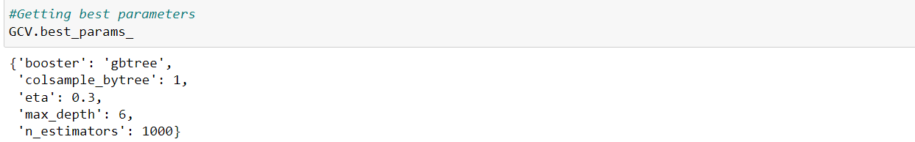
Hyperparameter Tuning:
I Have used 5 XGBClassifier parameters to be saved under the variable "parameters" that will be used in GridSearchCV for finding the best output. Assigned a variable to the GridSearchCV function after entering all the necessary inputs. And we used our training data set to make the GridSearchCV aware of all the hyper parameters that needs to be applied on our best model.

Slide 19
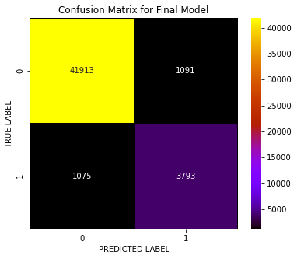
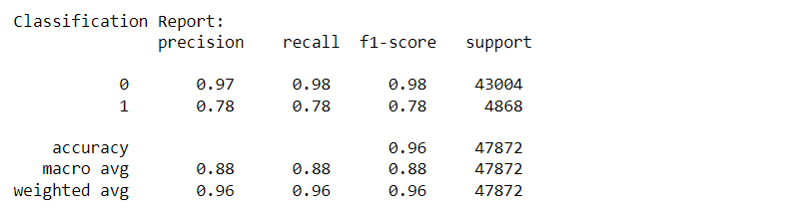
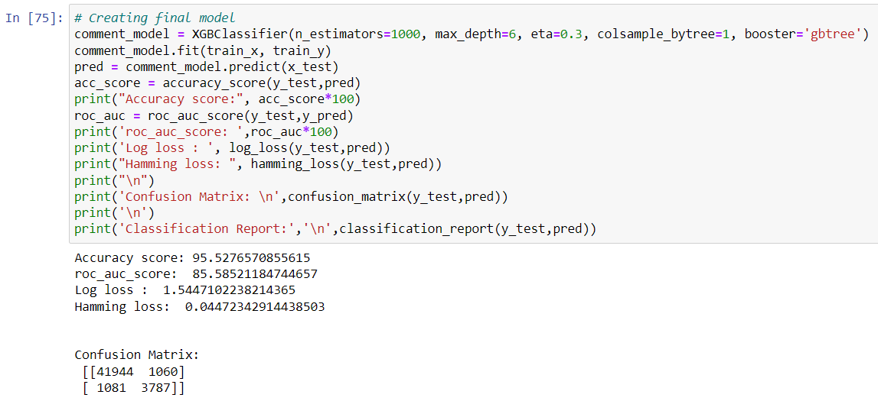
Creating Final Model After Tuning:
I have successfully incorporated the hyper parameter tuning using best parameters of XGBClassifier and the accuracy of the model has been increased after hyperparameter tuning and received the accuracy score as 95.52% which is very good.
With the help of confusion matrix we can able to see actual and predicted values for the final model. And also we can understand the number of times we got the correct outputs and the number of times my model missed to provide the correct prediction

Slide 20
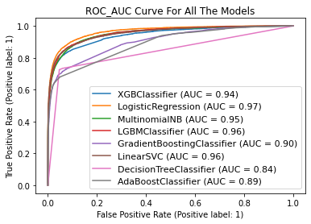
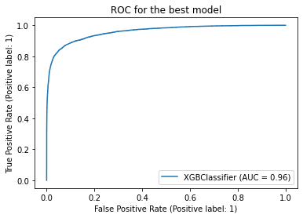
ROC-AUC Curve for all the models and for the best model:
ROC-AUC Curve for all the models
ROC-AUC Curve for final model
I have generated the ROC Curve for all the models and for the best model and compared with AUC. The AUC score for my final model to be of 96% which is increased after tuning the model as it can be observed from the curves.

Slide 21
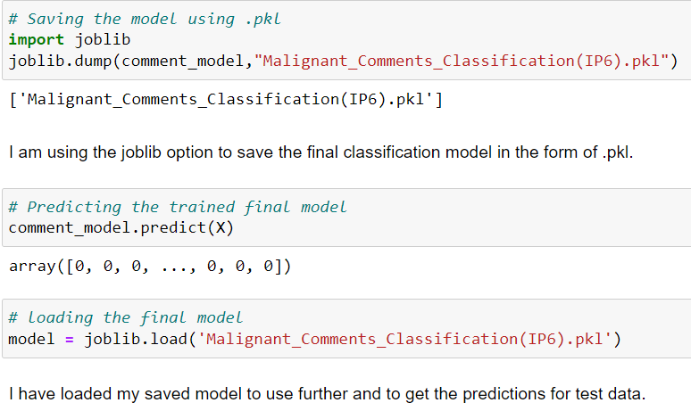
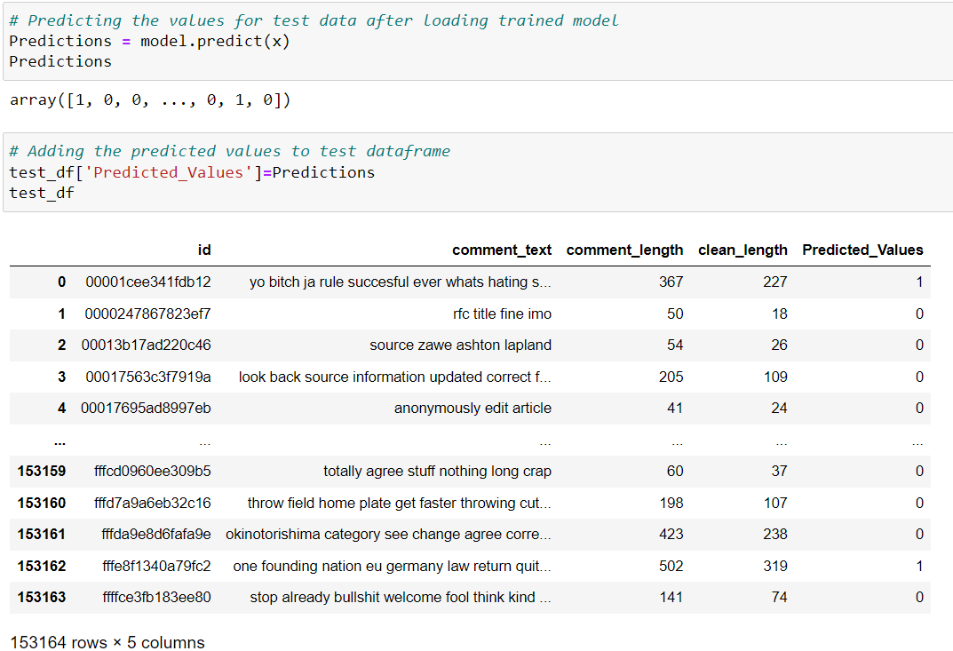
Saving The Final Model And Predictions From Saved Model
I have saved my final best model using joblib library in .pkl format, and loaded saved model for predictions for test data.
Using classification model, we have got the predicted values for malignant comments classification.

Slide 22
Conclusion:
This case study gives an idea of NLP text processing in machine learning. In this case study, apart from applying the techniques that we have learnt in the EDA module, we also classified hate and offensive comments so that it can be controlled and restricted from spreading hatred and cyberbullying.
From this dataset we were able to understand the idea of Natural Language Processing using machine learning models. This model helps us to understand whether the online comments are malignant or non malignant.
We have mentioned step by step procedure to analyse the data and checked the correlation between label and feature.
In this project there are some variables like malignant and rude which are highly correlated it is possible because one comment text may have combination of multiple features.
  • Removing the column id does not impact the model training.
  • Using Tree, model can reduce the false negative values
  • It has future scope in various use cases likewise in election, social media etc, where every day there are multi offensive comments spread.
Data cleaning is one of the most important steps to remove unrealistic values and unnecessary stop words.
We got XGB Classifier as best model and performed hyper parameter tuning using best parameters of XGB model and plotted AUC-ROC score and the model accuracy and roc-auc score increased after tuning.
After that we saved the model in a pickle with a filename in order to use whenever we require. Then we loaded the saved file and predicted the values for test data. Further we saved the predicted values test data into csv file.

Slide 23
Thank You

